Slide 1
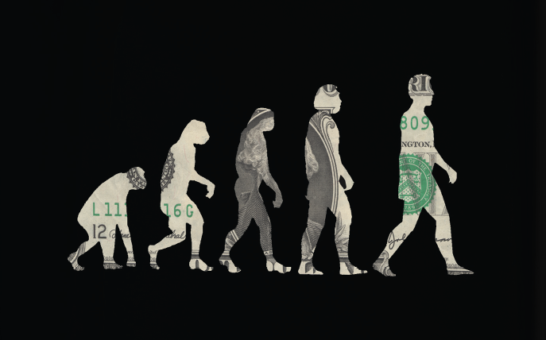
Adaptive Markets:
Financial Evolution at the
Speed of Thought
Andrew W. Lo, MIT
Museum of American Finance
January 24, 2018
TexPoint fonts used in EMF.
Read the TexPoint manual before you delete this box.: AAAAAAAAAAAAAAA

Slide 2

Markets are efficient
People behave irrationally

Slide 3


Slide 4
Personal Journey
Efficient Markets
Rational Expectations
Behavioral Finance
Psychology
Artificial Intelligence Bounded Rationality
Cognitive Neurosciences
Evolutionary Biology Ecology
Adaptive Markets Hypothesis

Slide 5
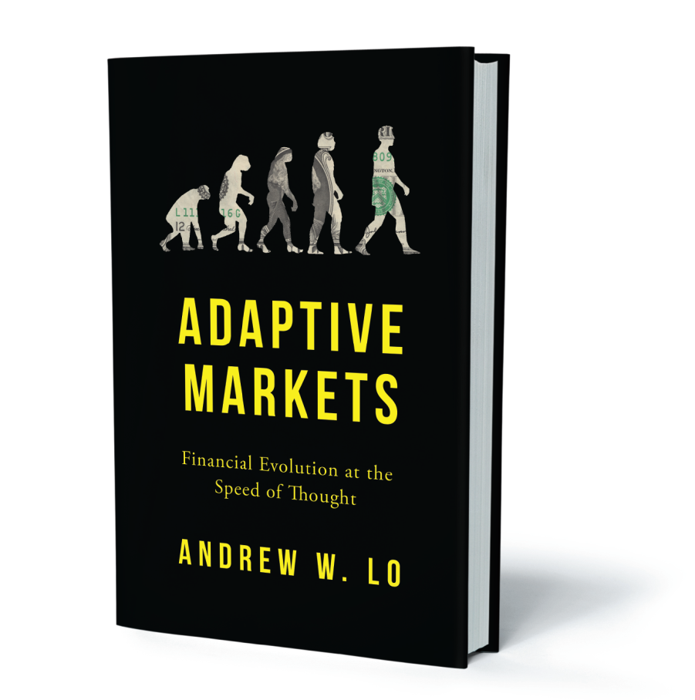


Slide 6
Summary
Traditional investment framework is flawed
Not wrong, but incomplete (physics envy)
Stable environment ⇒ stable investment policies (EMH)
Dynamic environment ⇒ dynamic investment policies (AMH)
The current environment is highly dynamic
We must adapt to changing market conditions
“it’s the economy, stupid”
The Adaptive Markets Hypothesis provides a framework for investing, risk management, financial regulation, and more
environment

Slide 7

The Traditional Investment Paradigm
In the beginning…
Implications:
Correlation matters; diversification
Benchmarks, performance attribution
Passive investing
Indexation, hedging, portable alpha
Risk budgeting
Framework for fiduciary duties

Slide 8
The Traditional Investment Paradigm
But This Framework Requires Several Key Assumptions:
Relationship is linear
Relationship is static across time and circumstances
Parameters can be accurately estimated
Investors behave rationally
Markets are stationary (static probability laws)
Markets are efficient
What If Some of These Assumptions Don’t Hold?

Slide 9
The Traditional Investment Paradigm
Cumulative Return of S&P 500 (log scale)
January 1926 to December 2015
But Do They Still Hold Today??
Assumptions Used To Hold
Source: CRSP and author’s calculations.

Slide 10
The Traditional Investment Paradigm
Nikkei 225 (log scale)
May 16, 1950 to May 13, 2016

Slide 11
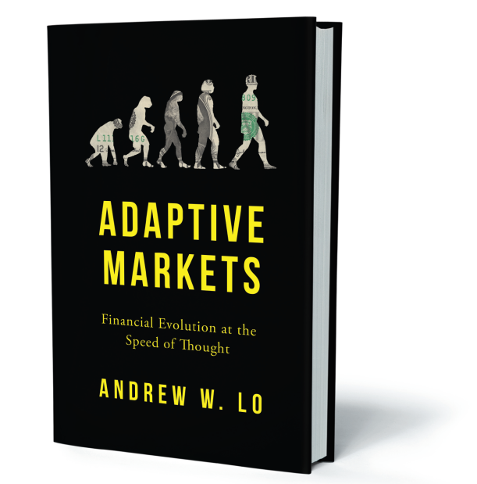
The Adaptive Markets Hypothesis
“Nothing makes sense in biology except in the light of evolution,” Dobzhansky (1973)
“Nothing makes sense in the hedge fund industry except in the light of the Adaptive Markets Hypothesis,” Lo (2017)
  Individuals act in their own self-interest
  Individuals make mistakes (“satisfice”)
  Individuals learn and adapt (heuristics)
  Competition drives adaptation and innovation
  Evolution determines market dynamics

Slide 12
What Do Investors Want?

Slide 13
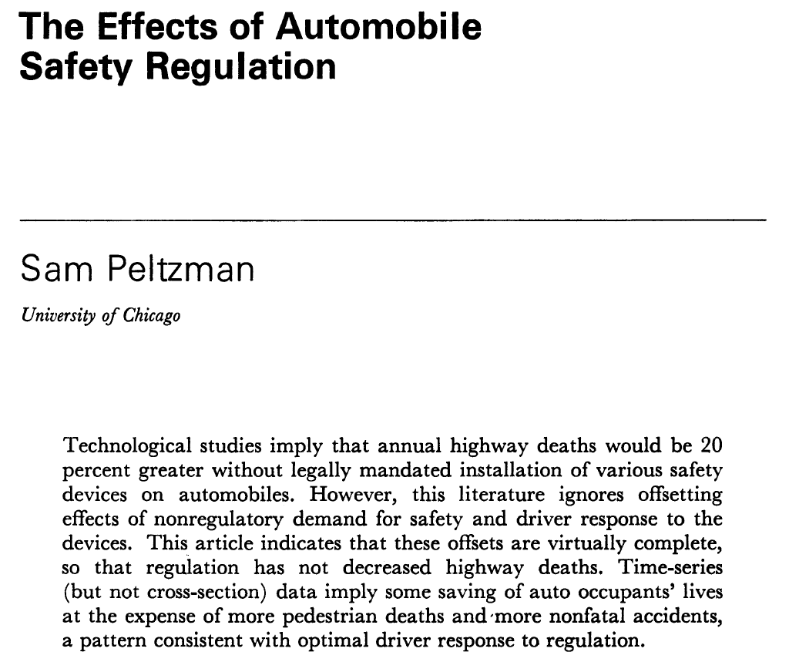
Risk Perception and Adaptive Behavior
Journal of Political Economy 83(1975), 677–726.

Slide 14
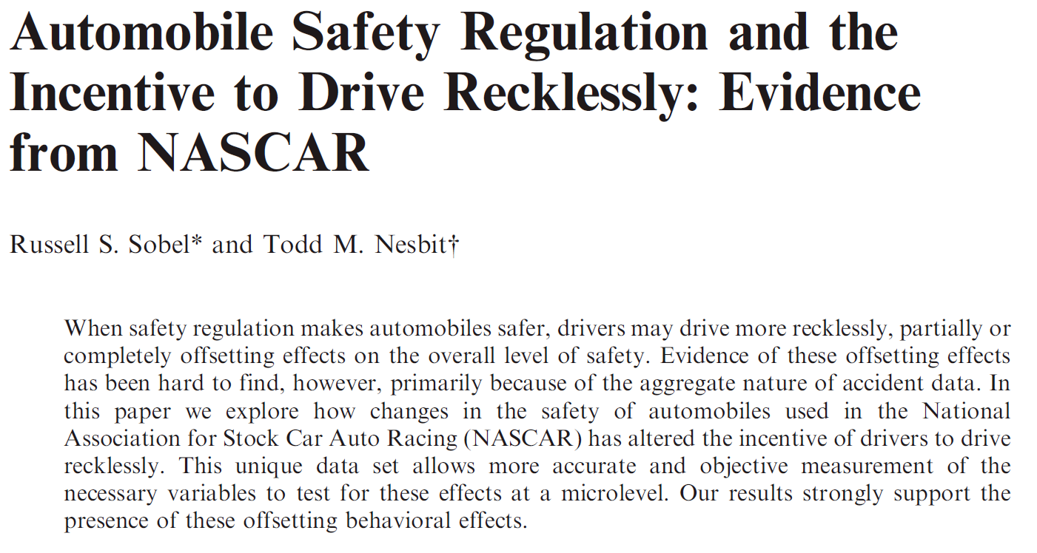
Risk Perception and Adaptive Behavior
Southern Economic Journal 74(2007), 71–84.

Slide 15
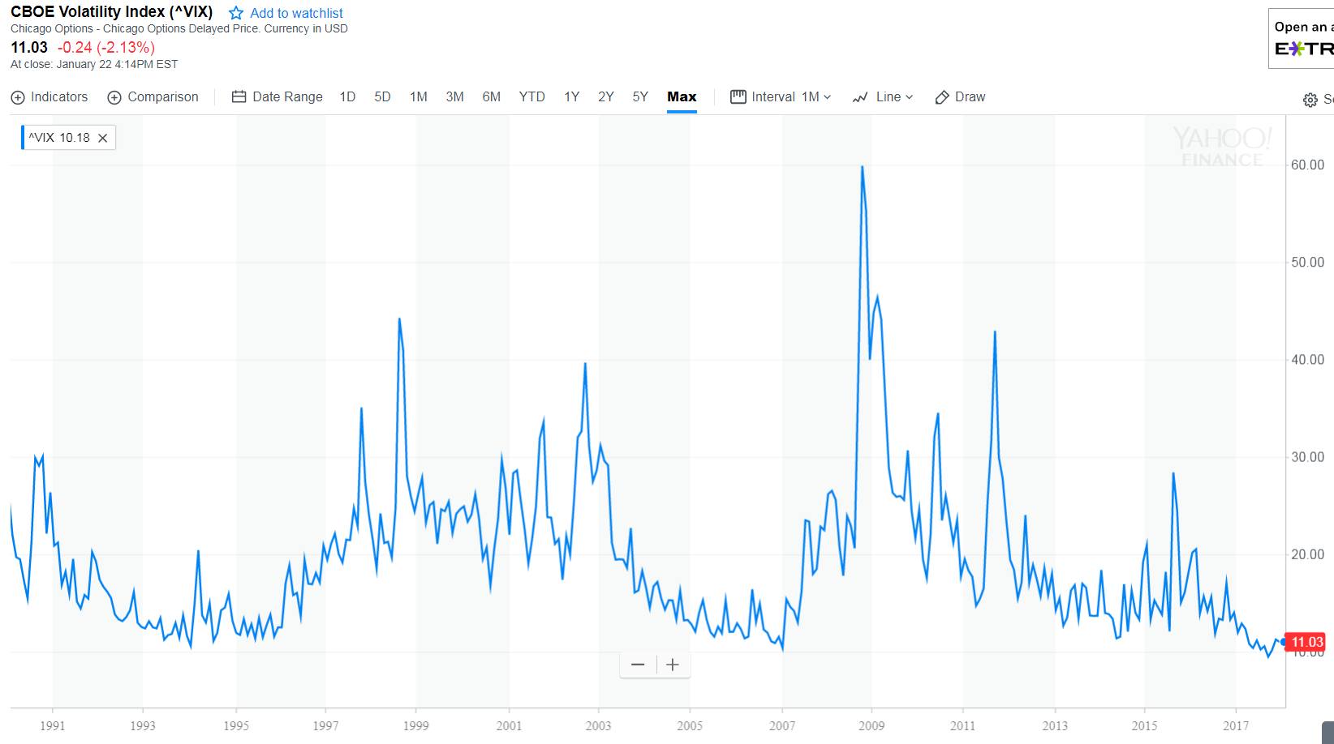
Implications for the Current Ecosystem
22 Jan 2018

Slide 16
A New Investment Paradigm Is Emerging
Efficient Markets
Long-only constraint
Diversify across stocks and bonds
Market-cap-weighted indexes
Manage risk via asset allocation
Alpha vs. market beta
Markets are efficient
Equities in the long run
Adaptive Markets
Long/short strategies
Diversify across more asset classes and strategies
Passive transparent indexes
Manage risk via active volatility scaling algorithms
Alphas ⇒ multiple betas
Markets are adaptive
“In the long run we’re all dead,” but make sure the short run doesn’t kill you first

Slide 17
A New Investment Paradigm Is Emerging
Efficient Markets
Long-only constraint
Diversify across stocks and bonds
Market-cap-weighted indexes
Manage risk via asset allocation
Alpha vs. market beta
Markets are efficient
Equities in the long run
Adaptive Markets
Long/short strategies
Diversify across more asset classes and strategies
Passive transparent indexes
Manage risk via active volatility scaling algorithms
Alphas ⇒ multiple betas
Markets are adaptive
“In the long run we’re all dead,” but make sure the short run doesn’t kill you first

Slide 18
What Is An Index??
Market-cap-weighted portfolio?
Jack Bogle (1997) on the Origins of the Vanguard Index Trust:
The basic ideas go back a few years earlier. In 1969–1971, Wells Fargo Bank had worked from academic models to develop the principles and techniques leading to index investing. John A. McQuown and William L. Fouse pioneered the effort, which led to the construction of a $6 million index account for the pension fund of Samsonite Corporation. With a strategy based on an equal-weighted index of New York Stock Exchange equities, its execution was described as “a nightmare”. The strategy was abandoned in 1976, replaced with a market-weighted strategy using the Standard & Poor's 500 Composite Stock Price Index. The first such models were accounts run by Wells Fargo for its own pension fund and for Illinois Bell.

Slide 19
What Is An Index??
Market-cap weighting requires little trading
“Buy-and-hold” portfolio
What if trading were cheaper, faster, and automatable?
In·dex \ˈin-ˌdeks\ noun
An index is any portfolio strategy satisfying three properties: (1) it is completely transparent; (2) it is investable; and (3) it is totally systematic.

Slide 20
What Is An Index??
Yes No Maybe
✓
Value-weighted average?
Equal-weighted average?
Target-date fund?
FHFA House Price Index?
Hedge Fund Index?
Trend-following futures?
Risk-managed large-cap core?
✓
✓
✓
✓
✓
✓

Slide 21
What Is An Index??

Slide 22
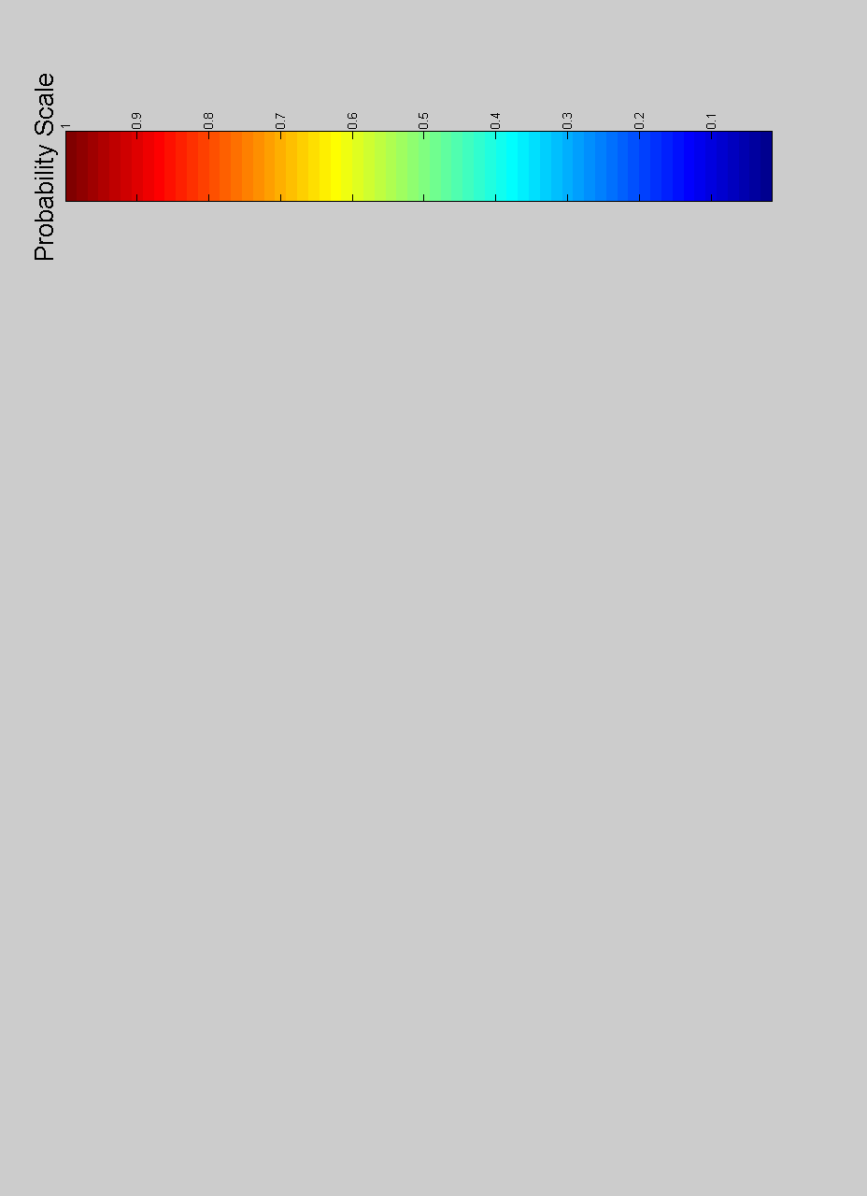
What Is An Index??
Hedge
Fund
Active
Active
Passive
Passive
Index
Fund
alpha
risk control

Slide 23
Full-Spectrum Investing
Hedge
Fund
Active
Active
High
High
High
High
High
High
High
Untapped Investment Opportunities
Passive
Passive
Low
Low
Low
Low
Low
Low
Low
Index
Fund
alpha
risk
control
credit
Sharpe
skew
liquidity
turnover
currency
max DD

Slide 24
The Opportunity: Precision Indexes
Instead of the DowJones30®, FTSE100®, or S&P500®, imagine investing in the:
  JaneDoe30®, RichardRoe100®, or <YourNameHere>500®
Imagine if such portfolios took into account income, expenses, age, health, taxes, and behavior ⇒ really smart beta!
Imagine if such portfolios were automated
We have the hardware and software; we need the algorithms

Slide 25
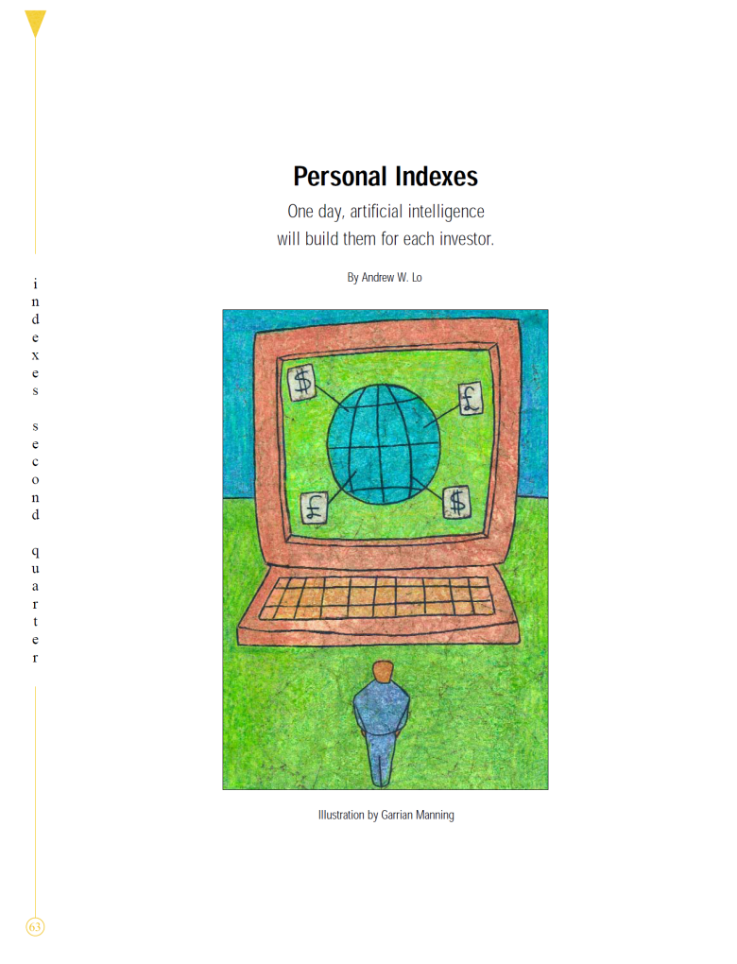
This Idea Is Not New
“Artificial intelligence and active management are not at odds with indexation, but instead imply a more sophisticated set of indexes and portfolio management policies for the typical investor, something each of us can look forward to, perhaps within the next decade.”
– Andrew W. Lo, Journal of Indexes Q2, 2001

Slide 26
So What’s Missing?
…Not Artificial Intelligence
Humanity
Artificial Stupidity
We need an algorithm for investor behavior so we can counterbalance our least productive actions (e.g., loss aversion, overconfidence, overreaction, etc.)

Slide 27
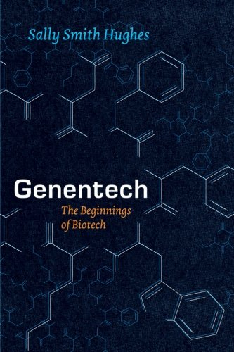

Artificial vs. Natural Intelligence
Expert systems vs. machine-learning techniques
Expensive storage ⇒ small data, complex code
Cheap storage ⇒ big data, simpler code
This is closer to natural intelligence! Narrative vs. facts

Slide 28



Friend or Foe?

Slide 29
Friend or Foe?
José
Susan
Gender and sex orientation (4) GM HF
Race/ethnicity (4) Latino White
Age (4) Young Prof. Mid. Age
Current home state (50) CA TX
Religious affiliation (4) None Christian
Political party (3) Democrat Republican
Economic status (3) Mid. Class Affluent
Education (3) MBA BA
345,600 Possible Types!
But Beware of Learning With Sparse Data

Slide 30
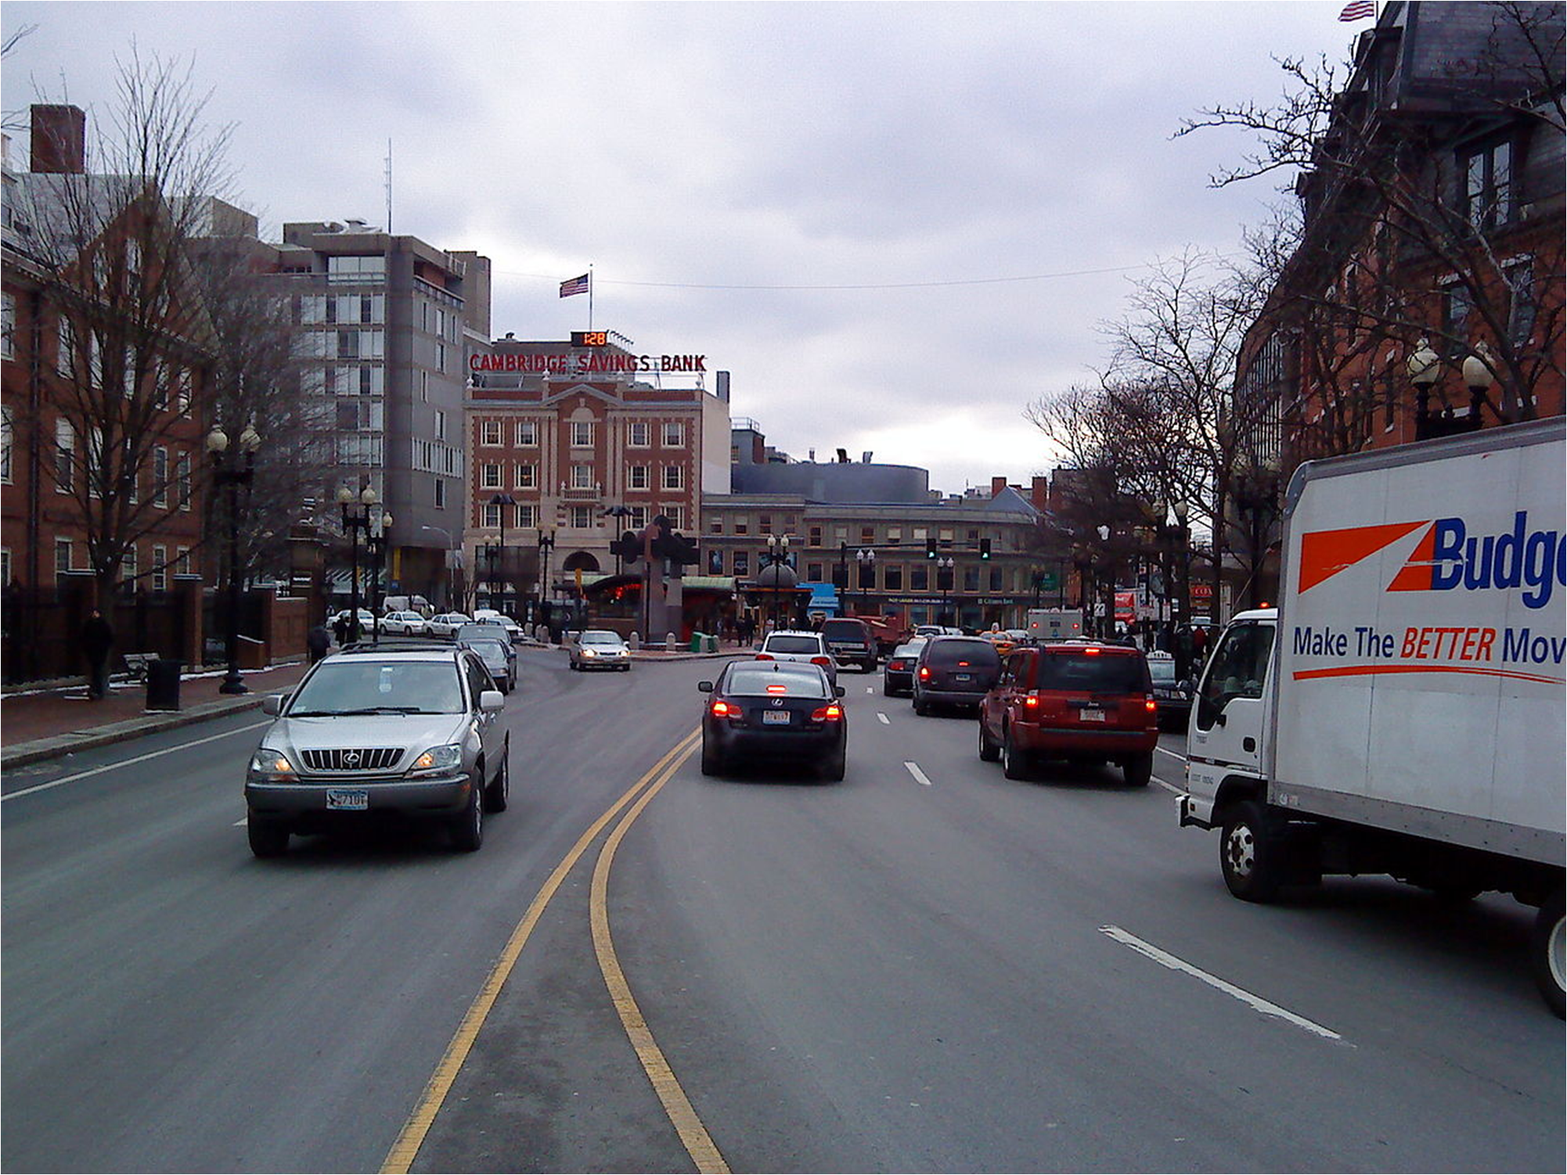

Slide 31
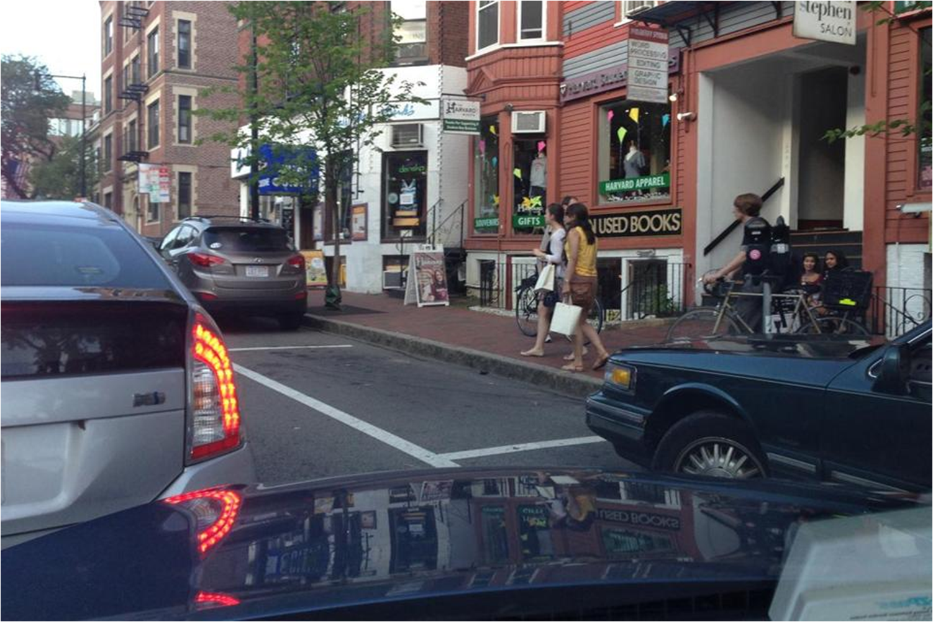

Slide 32

Evolution at the Speed of Thought
Aron Lee Ralston, 4/26/03
Notes:
Hiking on 4/26/03 in Blue John Canyon, Utah
Trapped for 127 hours
Finally escaped by amputating his own right forearm
How did he do this??
A different narrative!

Slide 33
Evolution at the Speed of Thought
A blond three-year-old boy in a red polo shirt comes running across a sunlit hardwood floor in what I somehow know is my future home. By the same intuitive perception, I know the boy is my own. I bend to scoop him into my left arm, using my handless right arm to balance him, and we laugh together as I swing him up to my shoulder… Then, with a shock, the vision blinks out. I’m back in the canyon, echoes of his joyful sounds resonating in my mind, creating a subconscious reassurance that somehow I will survive this entrapment. Despite having already come to accept that I will die where I stand before help arrives, now I believe I will live.
That belief, that boy, changes everything for me.
– Aron Lee Ralston (2005)

Slide 34

Evolution at the Speed of Thought
We Need New Narratives In Finance!
Notes:
In 2003, Ralston was not engaged, married, and had no children
Ralston married in August 2009; son Leo born in 2010

Slide 35
Thank You!
For more on Adaptive Markets:
http://bit.ly/2t3Sre6 (MIT Sloan Lecture)
http://bit.ly/2ty6Rqp (Clarendon Lectures)
http://alo.mit.edu (website)
@AndrewWLo (Twitter)

Slide 36
Additional References
Abbe, E., Khandani, A. and A. Lo, 2012, “Privacy-Preserving Methods for Sharing Financial Risk Exposures”, American Economic Review: Papers and Proceedings 102, 65–70.
Bisias, D., Flood, M., Lo, A., and S. Valavanis, 2012, “A Survey of Systemic Risk Analytics”, Annual Review of Financial Economics 4, 255–296.
Brennan, T. and A. Lo, 2012, “Do Labyrinthine Legal Limits on Leverage Lessen the Likelihood of Losses? An Analytical Framework”, Texas Law Review 90, 1775–1810.
Brennan, T. and A. Lo, 2014, “Dynamic Loss Probabilities and Implications for Financial Regulation”, to appear in Yale Journal on Regulation.
Butaru, F., Chen, Q., Clark, B., Das, S., Lo, A., and A. Siddique, 2015, “Risk and Risk Management in the Credit Card Industry” (June 14, 2015). Available at SSRN: http://ssrn.com/abstract=2618746 or http://dx.doi.org/10.2139/ssrn.2618746
Campbell, J., Lo, A. and C. MacKinlay, 1997, The Econometrics of Financial Markets. Princeton, NJ: Princeton University Press.
Chan, N., Getmansky, M., Haas, S. and A. Lo, 2007, “Systemic Risk and Hedge Funds”, in M. Carey and R. Stulz, eds., The Risks of Financial Institutions and the Financial Sector. Chicago, IL: University of Chicago Press.
Getmansky, M., Lo, A. and I. Makarov, 2004, “An Econometric Analysis of Serial Correlation and Illiquidity in Hedge-Fund Returns”, Journal of Financial Economics 74, 529–609.
Getmansky, M., Lo, A. and S. Mei, 2004, “Sifting Through the Wreckage: Lessons from Recent Hedge-Fund Liquidations”, Journal of Investment Management 2, 6–38.
Khandani, A., Kim, A. and A. Lo, 2010, “Consumer Credit Risk Models via Machine-Learning Algorithms”, Journal of Banking & Finance 34, 2767–2787.
Khandani, A. and A. Lo, 2007, “What Happened to the Quants In August 2007?”, Journal of Investment Management 5, 29–78.
Khandani, A. and A. Lo, 2009, “What Happened to the Quants in August 2007?: Evidence from Factors and Transactions Data”, to appear in Journal of Financial Markets.
Khandani, A., Lo, A., and R. Merton, 2013, “Systemic Risk and the Refinancing Ratchet Effect”, Journal of Financial Economics 108, 29–45.

Slide 37
Additional References
Kirilenko, A., and A. Lo, 2013, “Moore's Law vs. Murphy's Law: Algorithmic Trading and Its Discontents”, Journal of Economic Perspectives 27, 51–72.
Li, W., Azar, Larochelle, D., Hill, P. and A. Lo, 2015, “Law Is Code: A Software Engineering Approach to Analyzing the United States Code”, Journal of Business & Technology Law 10, 297–374.
Lo, A., 2001, “Risk Management for Hedge Funds: Introduction and Overview”, Financial Analysts Journal 57, 16–33 Lo, A., 2002, “The Statistics of Sharpe Ratios”, Financial Analysts Journal 58, 36–50.
Lo, A., 2002, “The Statistics of Sharpe Ratios”, Financial Analysts Journal 58, 36–50.
Lo, A., 2004, “The Adaptive Markets Hypothesis: Market Efficiency from an Evolutionary Perspective”, Journal of Portfolio Management 30, 15–29.
Lo, A., 2005, The Dynamics of the Hedge Fund Industry. Charlotte, NC: CFA Institute.
Lo, A., 2005, “Reconciling Efficient Markets with Behavioral Finance: The Adaptive Markets Hypothesis”, Journal of Investment Consulting 7, 21–44.
Lo, A., 2007, “Where Do Alphas Come From?: Measuring the Value of Active Investment Management”, to appear in Journal of Investment Management.
Lo, A., 2012, “Reading About the Financial Crisis: A 21-Book Review”, Journal of Economic Literature 50, 151–178.
Lo, A., 2013, “Fear, Greed, and Financial Crises: A Cognitive Neurosciences Perspective”, in J.P. Fouque and J. Langsam, eds., Handbook of Systemic Risk, Cambridge University Press.
Lo, A. and C. MacKinlay, 1999, A Non-Random Walk Down Wall Street. Princeton, NJ: Princeton University Press.
Lo, A., Petrov, C. and M. Wierzbicki, 2003, “It's 11pm—Do You Know Where Your Liquidity Is? The Mean-Variance-Liquidity Frontier”, Journal of Investment Management 1, 55–93.

